Slide 1
Decomposition of Graph

Slide 2

Decomposition of Graph
The remaining of this chapter covers:
graphs, with
Depth-First Search, and
Breadth-First Search, and
Topological Sorting
Strong Connected Components
Fake Coin Problem
Interpolation Search

Slide 3
Decrease-by-one technique - Recall
Graph:
A directed graph or digraph is a graph with directions specified for all its edges.
The adjacency matrix and adjacency lists are still two principal means of representing a digraph.
Depth-First Search and Breadth-First Search Algorithms
Viewed as applications of the decrease-by-one technique.
Doing their main job of visiting vertices and traversing edges of a graph.

Slide 4
Topological Sorting

Slide 5

Topological Sort
Let G = (V, E) be a directed acyclic graph (or, a dag).
A topological sort of a dag is a linear ordering of all its vertices such that
if G contains an edge (u, v), then u appears before v in the ordering.
If the graph contains a cycle, then no linear ordering is possible.
DFS can be used to perform a topological sort of a dag.
c

Slide 6
Topological Sort
A topological sort of a graph can be viewed as
an ordering of its vertices along a horizontal line so that all directed edges go from left to right.
Topological sorting is different from the usual kind of “sorting”.
Used in applications of precedence among events.

Slide 7
Topological Sort
For a directed acyclic graph (dag), it is always possible to linearize (or topologically sort).
By means of linearization,
the vertices is in the order of one after the other, and
every edge (u, v) goes from vertex u to vertex v, so that all precedence constraints are satisfied.
For example, one valid ordering is B, A, D, C, E, F.
(Can you find the other three?)
A
C
E
B A D C E F
F
B
D

Slide 8
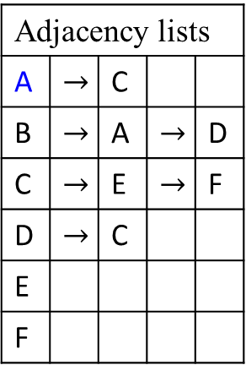
Topological Sort
Adjacency lists
A | $$→$$ | C
B | $$→$$ | A | $$→$$ | D
C | $$→$$ | E | $$→$$ | F
D | $$→$$ | C
E
F
Stack – Top
E_{3, 1} | F_{4, 2}
C_{2, 3} |  | D_{6, 5}
A_{1, 4} |  | B_{5, 6}
A C E
Pop-off Orderings and its Reverse
E_{3, 1} | F_{4, 2} | C_{2, 3} | A_{1, 4} | D_{6, 5} | B_{5, 6}
B_{5, 6} | D_{6, 5} | A_{1, 4} | C_{2, 3} | F_{4, 2} | E_{3, 1}
c
B D F
Figure 3.19. A directed acyclic graph with one source, two sinks,
and four possible linearization’s ways. And a redrawn graph.
One valid ordering is B, A, D, C, E, F.
(Can you find the other three?)
The other three linearization’s ways are : {B, A, D, C, F, E}, {B, D, A, C, E, F}, and {B, D, A, C, F, E}. (- reverse of pop off orderings.)
B
A
D
C
E
F

Slide 9
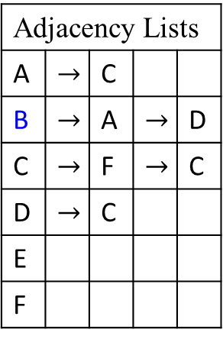
Topological Sort
Adjacency Lists
A | $$→$$ | C
B | $$→$$ | A | $$→$$ | D
C | $$→$$ | F | $$→$$ | C
D | $$→$$ | C
E
F
Stack - Top
F_{4, 1} | E_{5, 2}
C_{3, 3}
A_{2, 4} |  | D_{6, 5}
B_{1, 6}
A C E
Pop-off Orderings and its Reverse
F_{4, 1} | E_{5, 2} | C_{3, 3} | A_{5, 4} | D_{6, 5} | B_{1, 6}
B_{1, 6} | D_{6, 5} | A_{5, 4} | C_{3, 3} | E_{5, 2} | F_{4, 1}
B D F
Figure 3.19. A directed acyclic graph with one source, two sinks,
and four possible linearization’s ways. And a redrawn graph.
One valid ordering is B, A, D, C, E, F.
(Can you find the other three?)
The other three linearization’s ways are: {B, A, D, C, F, E}, {B, D, A, C, E, F}, and {B, D, A, C, F, E}. (- reverse of pop off orderings.)
B
A
D
C
F
E

Slide 10
Topological Sort
Property
Applying DFS on a dag, every edge leads to a vertex with a lower finishings number (pop-off ordering from the stack).
This gives us a linear-time algorithm for ordering the nodes of a dag.
Three(3) rather different-sounding properties:
acyclicity,
linearizability, and
the absence of back edges during a depth first search
are, in fact, the same property.

Slide 11
Topological Sort
Property
Every dag has at least one source and at least one sink.
This guaranteed existence of a source suggests an alternative approach to linearization (Reverse pop off orderings):
Find a source, output it, and delete it from one graph.
Repeat until the graph is empty.
Can you see why generates a valid linearization for any dag?
What happens if the graph has cycles?
And how can this algorithm be implemented in linear time?

Slide 12
Stack – Top
E_{3, 1} | F_{4, 2}
C_{2, 3} |  | D_{6, 5}
A_{1, 4} |  | B_{5, 6}
Topological Sort
The following simple algorithm topologically sorts a dag:
Topological-Sort (G)
Call DFS(G) to compute finishing time finish[v] for each vertex v.
As each vertex is finished, insert it onto the front of a linked list.
Return the linked list of vertices.
We can perform a topological sort in time Θ(V + E), since DFS
takes Θ(V + E) time and
takes O(1) time to insert each of the |V| vertices onto the front of the linked list.
Pop-off Orderings and its Reverse
F_{4, 1} | E_{5, 2} | C_{3, 3} | A_{5, 4} | D_{6, 5} | B_{1, 6}
B_{1, 6} | D_{6, 5} | A_{5, 4} | C_{3, 3} | E_{5, 2} | F_{4, 1}

Slide 13

Topological Sort
We prove the correctness of this algorithm using the following key lemma characterizing directed acyclic graphs.
Lemma 3.7
A directed graph G is acyclic if and only if a DFS of G yields no back edges.

Slide 14
(b) DFS forest of the digraph for the DFS traversal started at a.
Figure 3.20 (a) Digraph
a
b
a
d
black-edge
Apply DFS traversal algorithms for traversing digraph
c₃₁
b₂₂ e₅₄
a₁₃ d₄₅
c
forward-edge
b
e
The adjacency list for the digraph in Figure 3.20 is as follows:
a → b → c
b → a → c
c
d → c → e
e
cross-edge
d
c
e
Push-onto order is a b c d e.
Pop-off order is c b a e d.

Slide 15

Topological Sort
(b) DFS forest of the digraph for the DFS traversal started at a.
Figure 3.21 (a) Acyclic Digraph
Apply DFS traversal algorithms for traversing digraph
c₃₁
b₂₂ e₅₄
a₁₃ d₄₅
a
b
a
d
forward-edge
c
b
e
The adjacency list for the digraph in Figure 3.21 is as follows:
a → b → c
b → c
c
d → c → e
e
cross-edge
d
c
Push-onto order is a b c d e.
Pop-off order is c b a e d.
Reversed pop-off order is
d e a b c
linearize:
d → e a → b → c
e

Slide 16
Recall: Topological- Sort (G)
// A simple algorithm topologically sorts a dag G:
Call DFS(G) to compute finishing times Finish[v] (the order for popping off v from the stack) for each vertex v.
e.g., the popping off order for Figure 3.21 is
c₃₁ b₂₂ a₁₃ e₅₄ d₄₅
As each vertex is finished, insert it onto the front of a linked list (that is, reverse the order of all vertices after popped off from the stack).
e.g., d₄₅ → e₅₄ a₁₃ → b₂₂ → c₃₁
3. Return the lined list of vertices

Slide 17
Topological Sort
Directions on a graph’s edges lead to new questions about the graphs that are either meaningless or trivial for undirected graphs.
Theorem 3.7
Topological-Sort (G) produces a topological sort of the directed acyclic graph G provided as its input.

Slide 18
Topological Sort
Consider a set of five required courses {C1, C2, C3, C4, C5} a student has to take in some degree program. The courses can be taken in any order as long as the following course prerequisites are met:
C1 and C2 have no prerequisites,
C3 requires C1 and C2,
C4 requires C3; and
C5 requires C3 and C4.
The student can take only one course per term.
In which order should the student take the courses?

Slide 19
Topological Sort
As in Figure 3.22, the digraph in which vertices represent courses and directed edges indicate prerequisite requirements.
C1 C4
C3
C2 C5
Figure 3.22. Digraph representing the prerequisite structure of five courses.

Slide 20
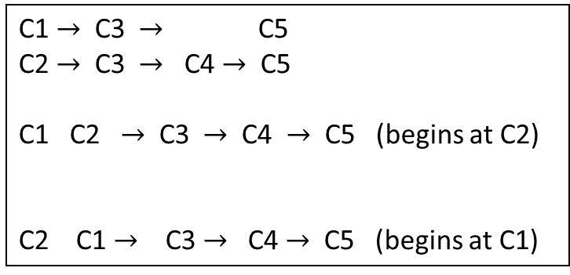
Topological Sort
A question is whether the vertices can be listed in such an order that for every edge in the digraph, the vertex where the edge starts is listed before the vertex where the edge ends. This problem is called topological sorting.
C1 C4
C3
C2 C5
Figure 3.22. Digraph representing the prerequisite structure of five courses.
C1 $→$ C3 $→$ C5
C2 $→$ C3 $→$ C4 $→$ C5
C1 C2 $→$ C3 $→$ C4 $→$ C5 (begins at C2)
C2 C1 $→$ C3 $→$ C4 $→$ C5 (begins at C1)

Slide 21
Topological Sort
For example: the topologically sorted list for this diagraph is.
C2 C1 C3 C4 C5
C1 C4
C3 Figure 3.22. Digraph representing the prerequisite structure of five courses.
C2 C5

Slide 22
Topological Sort
Being a dag is not only necessary but also sufficient for topological sorting to be possible.
if a digraph has no cycles, the topological sorting problem for it has a solution.
There are two efficient algorithms that
both verify whether a digraph is a dag and,
if it is, produce an ordering of vertices that solves the topological sorting problem.

Slide 23
Topological Sort
The first algorithm is a simple application of DFS:
Perform a DFS traversal and
record the order in which vertices become dead ends
(i.e., are popped off the traversal stack).
Reversing this order yields a solution to the topological sorting problem, provided no back edge has been encountered during the traversal.
If a back edge has been encountered, the digraph is not a dag, and topological sorting of its vertices is impossible.

Slide 24
Topological Sort
Why does the algorithm work?
When a vertex v is popped off a DFS stack, no vertex u with an edge from u to v can be among the vertices popped off before v.
Otherwise, (u, v) would have been a back edge.
Hence, any such vertex u will be listed after v in the popped-off order list, and before v in the reversed list.

Slide 25
Topological Sort – DFS Traversal
As in Figure 3.22, the digraph in which vertices represent courses and directed edges indicate prerequisite requirements.
C1 C4
C3
C2 C5
Figure 3.22. Digraph representing the prerequisite structure of five courses.
DFS traversal stack with the subscript numbers indicating the popping-off order.
C5₄₁
C4₃₂
C3₂₃
C1₁₄ C2₅₅

Slide 26
Topological Sort
For example: the topologically sorted list for this diagraph is.
C2 C1 C3 C4 C5
Solution to the problem
The popping-off order C5, C4, C3, C1, C2
C1 C4
C3 Figure 3.22. Digraph representing the prerequisite structure of five courses.
C2 C5

Slide 27
Topological Sort
The second algorithm is the source-removal algorithm, based on a direct implementation of the decrease (by-one)-and-conquer technique:
Repeatedly,
identify in a remaining digraph a source, which is a vertex with no incoming edges
delete it along with all the edges outgoing from it.
If there are several sources, break the tie arbitrarily.
If there is none, stop because the problem cannot be solved.
The order in which the vertices are deleted yields a solution to the topological sorting problem.

Slide 28
Topological Sort
The application of the source-removal algorithm to the same digraph representing the five courses is given in Figure 3.22: Digraph representing the prerequisite structure of five courses.
C1
C4
C3
C2 C5
C1 C4
delete C1
C3
C2 C5
Figure 3.22. Digraph representing the prerequisite structure of five courses.

Slide 29
Topological Sort
C1 C2
C4
C3
C2 C5
C4
delete C2
C3
C5
Figure 3.22. Digraph representing the prerequisite structure of five courses.

Slide 30
Topological Sort
C1 C2 C3
C4 C4
delete C3
C3
C5 C5
Figure 3.22. Digraph representing the prerequisite structure of five courses.

Slide 31
Topological Sort
C1 C2 C3 C4
C4
delete C4
C5 C5
Figure 3.22. Digraph representing the prerequisite structure of five courses.

Slide 32
Topological Sort
The solution obtained is
C1, C2, C3, C4, C5
after C5 is deleted
delete C5
C5
Figure 3.22. Digraph representing the prerequisite structure of five courses.
C1 C2 C3 C4 C5

Slide 33
Topological Sort
Note that the solution obtained by the source-removal algorithm is different from the one obtained by the DFS-based algorithm.
Both of them are correct.
The topological sorting problem may have several alternative solutions.

Slide 35
Graph
So far, we have addressed :
How can we represent a graph in a computer,
Addressed DFS and BFS algorithms based on search a graph.
Gave an application of DFS: topologically sorting a directed acyclic graph.
Will give decomposing a direct graph into its strongly connected components.

Slide 36
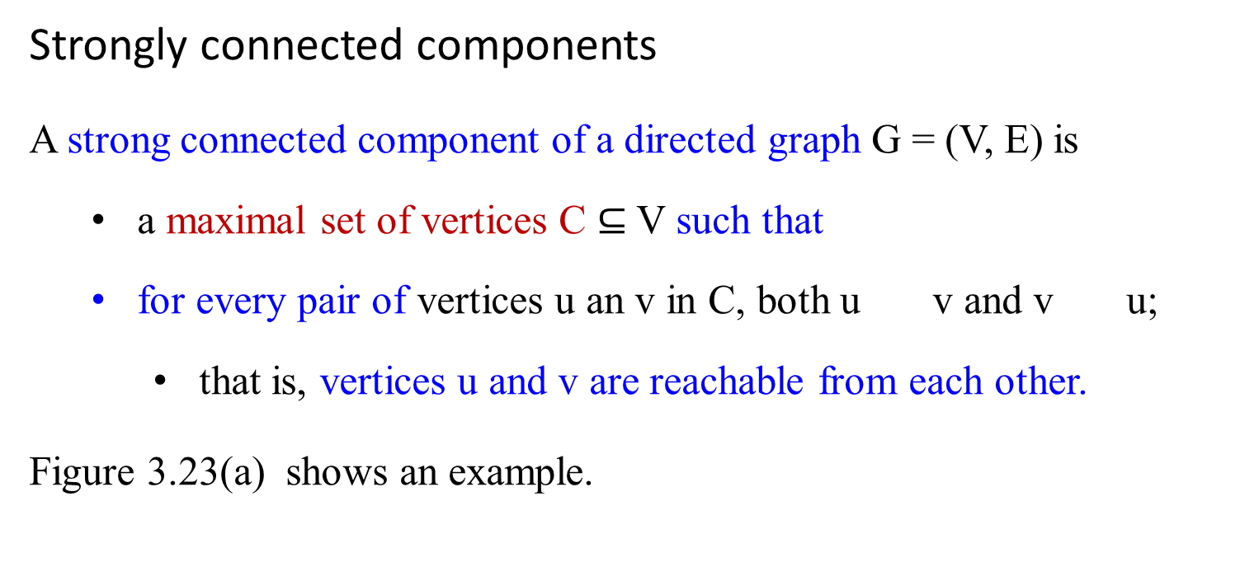
Graph - Strongly connected components
Strongly connected components
A strong connected component of a directed graph G = (V, E) is
a maximal set of vertices C $⊆$V such that
for every pair of vertices u an v in C, both u v and v u;
that is, vertices u and v are reachable from each other.
Figure 3.23(a) shows an example.
c

Slide 37
Graph - Strongly connected components
Figure 3.23 (a)
Figure 3.23(a) A direct graph G.
Each shaded region is a strongly connected component of G.
Each vertex is labeled with its discovery and finishing times in a depth-first search, and tree edges are shaded (as thick dark arrow lines, with c and b as the roots of the DFS tree forest).
a
b
c
d
13/14
11/16
1/10
8/9
e
12/15
3/4
2/7
5/6
f
g
h

Slide 38
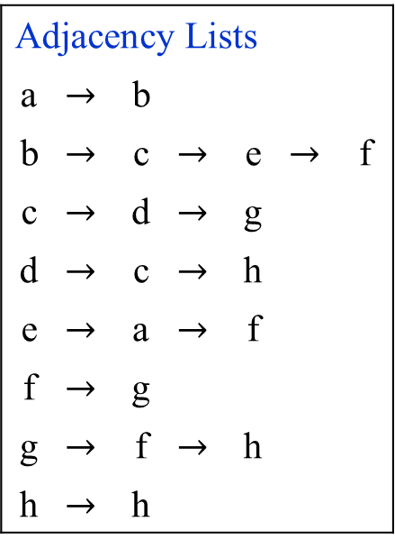
Graph - Strongly connected components
Adjacency Lists
a | $$→$$ | b
b | $$→$$ | c | $$→$$ | e | $$→$$ | f
c | $$→$$ | d | $$→$$ | g
d | $$→$$ | c | $$→$$ | h
e | $$→$$ | a | $$→$$ | f
f | $$→$$ | g
g | $$→$$ | f | $$→$$ | h
h | $$→$$ | h
Figure 3.23(a) A direct graph G. Another example of DFS traversal on G
a
b
c
d
1/16
2/15
3/12
4/7
e
13/14
a
h_{5, 1} | f_{7, 3}
d_{4, 2} | g_{6, 4}
c_{3, 5} |  | e_{8, 6}
b_{2, 7}
a_{1, 8}
8/11
5/6
b
9/10
c
e
f
g
h
d
g
h
f

Slide 39
Graph - Strongly connected components
a 1/16
b 2/15
Figure 3.23(a) A direct graph G.
c 3/12
e 13/14
d 4/7
g 8/11
h 5/6
f 9/10

Slide 40
Graph - Strongly connected components
Figure 3.23(c) The acyclic component graph G^{SCC} obtained by contracting all edges within each strongly connected component of G so that only a single vertex remains in each component.
How to obtain this acyclic component graph from a give G?
abe
cd
fg
h

Slide 41
Graph - Strongly connected components
Define the transpose of a directed graph G = (V, E) as
the graph G^{T} = (V, E^{T} ), where
E^{T} = {(v, u) ɛ V x V | (u, v) ɛ E}.
Thus, G^{T} is G with all its edges reversed.
Given an adjacency-list representation of G,
the time to create G^{T} is O(| V | + | E |).
An algorithm for finding strongly connected components of a graph G = (V, E) uses the transpose of G.

Slide 42
Graph - Strongly connected components
Observe:
G and G^{T} have exactly the same strongly connected components:
Vertices u and v are reachable from each other in G if and only if they are reachable from each other in G^{T}.
Figure 3.23 (b) shows the transpose of the graph in Figure 3.23 (a), with the strongly connected components shaded.

Slide 43
Graph - Strongly connected components
The graph G^{T}, the transpose of G, with the depth-first forest computed in line 3 of Strongly-Connected-Components shown and tree edges shaded.
Each strongly connect component in G^{T} corresponds to one depth-first tree.
Vertices a, c, f and h, which are white shaped, are the roots of the depth-first trees produced by the depth-first search of G^{T}.
Figure 3.23 (b)
a
b
c
d
e
f
g
h

Slide 44
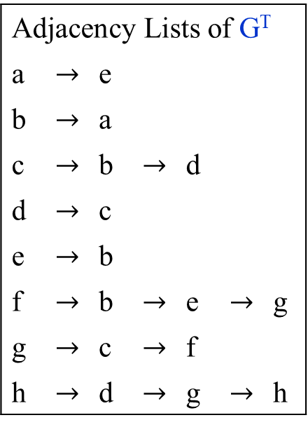
Graph - Strongly connected components
Adjacency Lists of G^{T}
a | $$→$$ | e
b | $$→$$ | a
c | $$→$$ | b | $$→$$ | d
d | $$→$$ | c
e | $$→$$ | b
f | $$→$$ | b | $$→$$ | e | $$→$$ | g
g | $$→$$ | c | $$→$$ | f
h | $$→$$ | d | $$→$$ | g | $$→$$ | h
Figure 3.23(b) The graph G^{T}, the transpose of G. DFS traversal on G^{T}.
a
b
c
d
e
a
b_{3, 1}
e_{2, 2} | d_{5, 4} | f_{7, 6}
a_{1, 3} | c_{4, 5} | g_{6, 7} | h_{8, 8}
e
c
f
b
f
g
h
d
h
g

Slide 45
Strongly-Connected-Components(G)
Call DFS(G) to compute finishing times Finish[u] for each vertex u.
Compute G^{T}.
Call DFS(G^{T} ), but in the main loop of DFS, consider the vertices in order of decreasing Finish[u] (as computed in line 1).
Output the vertices of each tree in the depth-first forest formed in line 3 as a separate strongly connected component.

Slide 46
Graph - Strongly connected components
The following linear-time (i.e., Θ(|V| + |E|)-time) algorithm computes:
the strongly connected components of a directed graph G = (V, E) using two depth-first search, one on G and one on G^{T}.

Slide 47
Graph - Strongly connected components
The idea behind this algorithm comes from a key property of the strongly connect component graph G^{SCC} = (V^{SCC} , E^{SCC}), which is defined as follows.
Suppose that G has strongly connected components C₁ , C₂, …, C_{k} .
The vertex set V^{SCC} is { v₁ , v₂, …, v_{k} }, and it contains a vertex v_{i} for each strongly connected component C_{i} of G.
There is an edge (v_{i} , v_{j}) ɛ E^{SCC} if G contains a directed edge (x, y) for some x ɛ C_{i} and y ɛ C_{j} .
Looked at another way, by contracting all edges whose incident vertices are within the same strongly connected component of G, the resulting graph is G^{SCC}.
Figure 3.23 (c) shows the component graph of the graph in Figure 3.23 (a).

Slide 48
Graph - Strongly connected components
(c) The acyclic component graph G^{SCC} obtained by contracting all edges within each strongly connected component of G so that only a single vertex remains in each component.
abe
cd
fg
h

Slide 49
Graph - Strongly connected components
Here is another way to look at how the second DFS operates.
Consider the component graph (G^{T})^{SCC} of G^{T} .
If we map each strongly connected component visited in the second DFS to a vertex of (G^{T})^{SCC}, the second DFS visits vertices of (G^{T})^{SCC} in the reverse of a topologically sorted order.
If we reverse the edges of (G^{T})^{SCC} , we get the graph ((G^{T})^{SCC})^{T}.
Because ((G^{T})^{SCC})^{T} = G^{SCC} , the second DFS visits the vertices of G^{SCC} in topologically sorted order.

Slide 50
Decrease-by-a-Constant-Factor Algorithm
Fake-Coin Identification Problem

Slide 51
Decrease-by-a-Constant-Factor Algorithm
Fake-Coin Identification Problem
Among n identically looking coins, one is fake.
The problem is to design an efficient algorithm for detecting the fake coin.
With a balance scale, we can compare any two sets of coins.
By staying even, tipping to the left, or to the right, the balance scale will tell whether the sets weigh the same or which of the sets is heavier than the other but not by how much.
An easier version of the problem – the one we discuss here – assumes that it is known whether the fake coin is lighter or heavier than the genuine one. (We assume that the fake coin is lighter.)

Slide 52
Decrease-by-a-Constant-Factor Algorithm
Solving this Fake-Coin Identification Problem:
(We assume that the fake coin is lighter. And therefore, the answer is “the fake coin is lighter”.)
Divide n coins into two piles of └n/2┘ coins each, leaving one extra coin apart if n is odd, and
put it two piles on the scale.
If the piles weigh the same, the coin put aside must be fake;
otherwise, we can proceed in the same manner with the lighter pile, which must be the one with the fake coin.
Note that even though we divide the coins into two subsets, after one weighing we are left to solve a single problem of half the original size.

Slide 53
Decrease-by-a-Constant-Factor Algorithm
Solving this Fake-Coin Identification Problem:
(We assume that the fake coin is lighter. And therefore, the answer is “the fake coin is lighter”.)
According to our classification of the design techniques, it is a decrease (by half)-and-conquer rather than a divide-and-conquer algorithm.
Set up a recurrence relation for the number of weighings, W(n) needed by this algorithm in the worst case:
W_{worst}(n) = W_{worst}(└n/2┘ ) + 1 for n > 1,
W_{worst}(1) = 0.

Slide 54
Decrease-by-a-Constant-Factor Algorithm
Solving this Fake-Coin Identification Problem:
(We assume that the fake coin is lighter. And therefore, the answer is “the fake coin is lighter”.)
This recurrence is almost identical to the one for the worst-case number of comparisons in binary search, and both algorithms [i.e., binary search and fake-coin identification] are based on the technique of halving an instance size.
The solution to the recurrence for the number of times of using the balance scale is also similar to the one we had for binary search: W(n) = └log₂n┘
In fact, this algorithm is not the most efficient solution.
We would be better off dividing the coins not into two but into three piles of about n/3 coins each.

Slide 55
Decrease-by-a-Constant-Factor Algorithm
Solving this Fake-Coin Identification Problem:
(We assume that the fake coin is lighter.)
After weighing two of the piles, we can reduce the instance size by a factor of three.
Accordingly, we should expect the number of weighings to be about log₃n, which is smaller than log₂n.
(Can you tell by what factor? By two-third.
Is this correct? The recurrence relation for this method is: W(n) = W(└n/3┘ ) + 1 for n > 2,
W(2) = 1 and W(1) = 0.

Slide 56
Decrease-by-a-Constant-Factor Algorithm
Solving this Fake-Coin Identification Problem:
(We assume that the fake coin is lighter.)
After weighing two of the piles, we can reduce the instance size by a factor of three.
Is this correct? The recurrence relation for this method is: W(n) = W(└n/3┘ ) + 1 for n > 2,
W(2) = 1 and W(1) = 0.
Problem is: not all the value of n that are multiples of 3. i.e., n = 3^{k}.
For large values of n, about how many times faster is this algorithm than the one based on dividing coins into two piles.
The answer should not depend on n.

Slide 57
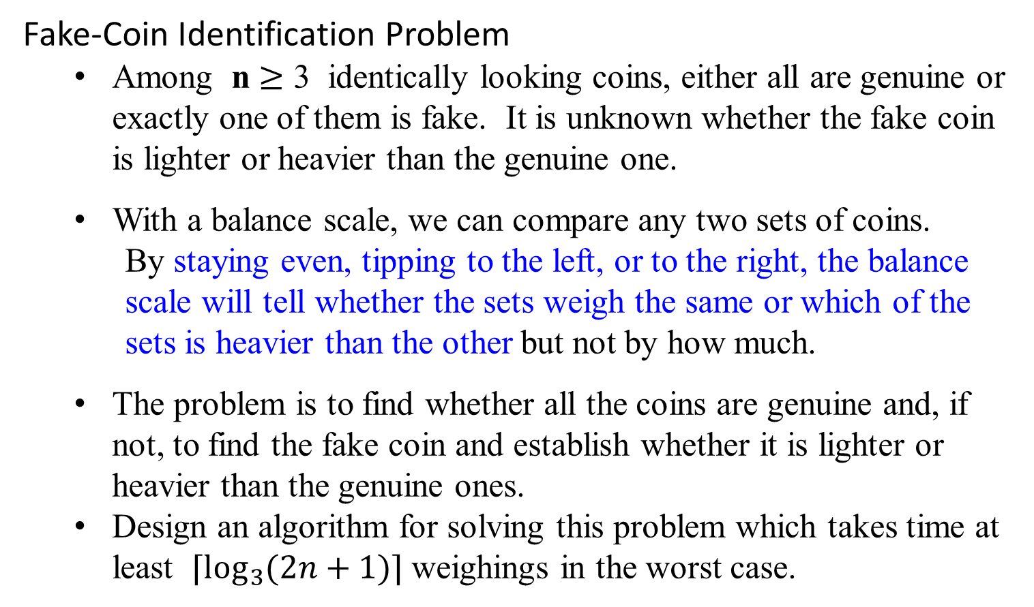
Decrease-by-a-Constant-Factor Algorithm
Fake-Coin Identification Problem
Among n $≥$ 3 identically looking coins, either all are genuine or exactly one of them is fake. It is unknown whether the fake coin is lighter or heavier than the genuine one.
With a balance scale, we can compare any two sets of coins.
By staying even, tipping to the left, or to the right, the balance scale will tell whether the sets weigh the same or which of the sets is heavier than the other but not by how much.
The problem is to find whether all the coins are genuine and, if not, to find the fake coin and establish whether it is lighter or heavier than the genuine ones.
Design an algorithm for solving this problem which takes time at least ⌈$\log_{3}{(2n+1)}⌉$ weighings in the worst case.

Slide 58
Variable-Size-Decrease-Algorithms
Interpolation Search

Slide 59
Variable-Size-Decrease-Algorithms
Interpolation Search
An example of a variable-size-decrease algorithm.
Consider an interpolation search. algorithm for sorted array.
Interpolation search takes into account the value of the search key, in order to find the array’s element to be compared with the search key.
The algorithm mimics the way we search for a name in a telephone book:
if we are searching for someone named Brown, we open the book not in the middle but very close to the beginning, unlike our action when searching for someone named, say, Smith.

Slide 60
Variable-Size-Decrease-Algorithms
Interpolation Search
More precisely, on the iteration dealing with the array’s portion between the leftmost element A[l] and the rightmost element A[r],
the algorithm assumes that the array’s values increase linearly, i.e., along the straight line through the points (l, A[l]) and (r, A[r]).
The accuracy of this assumption can influence the algorithm’s efficiency but not its correctness.
Accordingly, the search key’s value v is compared with the element whose index is computed as (the roundoff of) the x coordinate of the point on the straight line through the points (l, A[l]) and (r, A[r]) whose y coordinate is equal to the search value v. [See Figure 3.25]

Slide 61
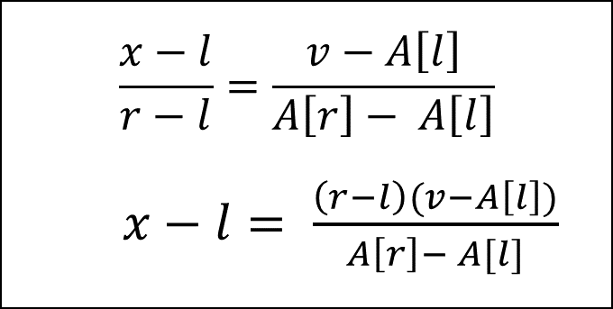
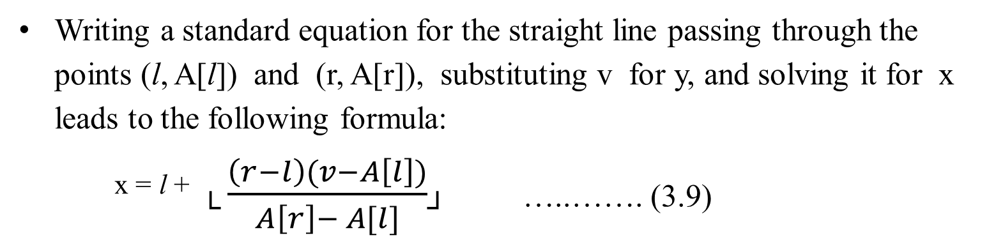
Interpolation Search
Writing a standard equation for the straight line passing through the points (l, A[l]) and (r, A[r]), substituting v for y, and solving it for x leads to the following formula:
^{x = l +} └ $\frac{\left(r−l\right)(v−A\left[l\right])}{A\left[r\right]− A[l]}$┘ …..……. (3.9)
value
A[r]
$$\frac{x−l}{r−l}=\frac{v−A\left[l\right]}{A\left[r\right]− A\left[l\right]}$$
$x−l= \frac{\left(r−l\right)(v−A\left[l\right])}{A\left[r\right]− A[l]}$
v = A[x]?
A[l]
l x r index
Figure 3.25 Index computation in interpolation search

Slide 62
Variable-Size-Decrease-Algorithms
Interpolation Search
The logic behind this approach:
We know that
the array values are increasing (more accurately, not decreasing) from A[l] to A[r],
but we do not know how they do it.
Had the array’s values increased linearly, which is the simplest manner possible, the index computed by formula (3.9) would be the expected location of the array’s element with the value equal to v.
If v is not between A[l] and A[r], formula (3.9) need not be applied (why?)

Slide 63
Variable-Size-Decrease-Algorithms
Interpolation Search
After comparing v with A[x], the algorithm
either stops (if they are equal) or
proceeds by searching in the same manner among the elements indexed either between l and x-1 or between x+1 and r, depending on which A[x] is smaller of larger than v.
Thus, the size of the problem’s instance is reduced, but we cannot tell a priori by how much.

Slide 64
Variable-Size-Decrease-Algorithms
Interpolation Search
The analysis of the algorithm’s efficiency shows that
interpolation search uses fewer than log₂ log₂ n + 1 key comparisons on the average when search in a list of n random keys.
This function grows so slowly that the number of comparisons will be a very small constant for all practically feasible inputs. (Why?)
For the worst case, interpolation search is only linear, which must be considered as a bad performance. (Why?)
As a final assessment of the worthiness of interpolation search versus that of binary search,
the binary search is probably better for smaller files but
interpolation search is worth considering for large files and for applications which comparisons are particularly expensive or access costs are very high.

Slide 65
Summary for Decrease and Conquer Algorithm Design Techniques
Three major variations of decrease-and-conquer:
Decrease by a constant. Most often by one. Insertion sort, Topological sorting (DFS). T(n) = T(n - c) + f(n)
Decrease by a constant factor. Most often by the factor of two. Binary Search, fake coin problem. T(n) = T(n/b) + f(n)
Variable size decrease. Euclid’s algorithm, the partition-based algorithm for interpolation search.

Slide 66
Summary for Decrease and Conquer Algorithm Design Techniques
Two algorithms for solving the topological sorting problem.
One is based on depth-first-search and
the other one is based on a direct application of the decrease-by-on-technique.
Binary Search for searching in a sorted array is a principal example of a decrease-by-a-constant-factor algorithm.
Other examples include exponentiation by squaring, identifying a fake coin with a balance scale, Russian peasant multiplication, and the Josephus problem.
Examples of variable size decrease algorithms include Euclid’s algorithm, the partition-based algorithm for selection search, interpolation search, and searching and insertion in a binary search tree.

